Slide 2
WELCOME!

Slide 3
WELCOME!
Objectives

Slide 4
WELCOME!
Objectives
Understand the importance and value of a speaker one-sheet

Slide 5
WELCOME!
Objectives
Understand the importance and value of a speaker one-sheet
Get a simple speaker one-sheet template for your use

Slide 6
WELCOME!
Objectives
Understand the importance and value of a speaker one-sheet
Get a simple speaker one-sheet template for your use
Understanding of what needs to be included on the one-sheet

Slide 7
WELCOME!
Objectives
Understand the importance and value of a speaker one-sheet
Get a simple speaker one-sheet template for your use
Understanding of what needs to be included on the one-sheet
Acquire resources for further assistance with your speaker one-sheet should you desire

Slide 8
WELCOME!
Objectives
Understand the importance and value of a speaker one-sheet
Get a simple speaker one-sheet template for your use
Understanding of what needs to be included on the one-sheet
Acquire resources for further assistance with your speaker one-sheet should you desire
Conclude workshop by 4 PM

Slide 9
RELAX!
If you’re a member of the Speakers Enrichment Academy or you’ve paid the guest admission fee to attend today’s workshop, we’ll be sending you a copy of the slide deck from today’s presentation along with a copy of the speaker one-sheet template and the resources sheet shown during todays presentation

Slide 10
RELAX!
If you’re a member of the Speakers Enrichment Academy or you’ve paid the guest admission fee to attend today’s workshop, we’ll be sending you a copy of the slide deck from today’s presentation along with a copy of the speaker one-sheet template and the resources sheet shown during todays presentation
Please type your name and email address in the chat box so we can get this info to you ASAP

Slide 11
Let’s Get Started!

Slide 12
What’s the Purpose of a Speaker One-Sheet?

Slide 13
What’s the Purpose of a Speaker One-Sheet?
Ultimate purpose of the One Sheet is to make the initial cut to the “short list” of potential speakers/presenters

Slide 14
What’s the Purpose of a Speaker One-Sheet?
Ultimate purpose of the One Sheet is to make the initial cut to the “short list” of potential speakers/presenters
Answer the event planner or conference organizers questions: “Who is this speaker? What is their brand? What are they known for? Are they going to fit and support the theme of the program?

Slide 15
What’s the Purpose of a Speaker One-Sheet?
Ultimate purpose of the One Sheet is to make the initial cut to the “short list” of potential speakers/presenters
Answer the event planner or conference organizers questions: “Who is this speaker? What is their brand? What are they known for? Are they going to fit and support the theme of the program?
What will our audience take away from this speakers session if we were to choose them?

Slide 16
What’s the Purpose of a Speaker One-Sheet?
Ultimate purpose of the One Sheet is to make the initial cut to the “short list” of potential speakers/presenters
Answer the event planner or conference organizers questions: “Who is this speaker? What is their brand? What are they known for? Are they going to fit and support the theme of the program?
What will our audience take away from this speakers session if we were to choose them?
Would this be a safe choice???

Slide 17
What’s the Purpose of a Speaker One-Sheet?
Ultimate purpose of the One Sheet is to make the initial cut to the “short list” of potential speakers/presenters
Answer the event planner or conference organizers questions: “Who is this speaker? What is their brand? What are they known for? Are they going to fit and support the theme of the program?
What will our audience take away from this speakers session if we were to choose them?
Would this be a safe choice???
Ultimately: Do we want to know more? Ask for a demo reel? References? More details? Do you make the short list?

Slide 18
Here’s the Dirtiest Secret Re; Speaker One-Sheets

Slide 19
Here’s the Dirtiest Secret Re; Speaker One-Sheets
The most value in a speaker one sheet is

Slide 20
Here’s the Dirtiest Secret Re; Speaker One-Sheets
The most value in a speaker one sheet is
The value you get from creating the one sheet.
The introspection.
The creative wordsmithing.
The pruning of your bio.
The creative titles of your programs
The audience take-aways you identify
The clarity you gain from going through the process of creating it

Slide 21
The Greatest Value of Your One Sheet
Ultimately, the confidence you gain from going through the process and knowing you’re among the few professionals who actually take the time, and dedicate the effort to create one of the most fundamental tools that a true professional public speaker has in his/her tool-box to promote themselves

Slide 22
Let’s Get To Work!

Slide 23
SPEAKER NAME
SPEAKER • AUTHOR • COACH
Connect With SPEAKER NAME on Social Media:
Facebook.com/SpeakerName
Twitter.com/SpeakerName
Contact me at: 555-555-1212 www.MyWebsite.com
COMPELING HEADLINE
Copy to describe the presentation including:
Bullet Point 1
Details to describe this point
Bullet Point 2
Details to describe this point
Bullet Point 3
Details to describe this point
CALL SPEAKER NAME TODAY AT: 555-555-1212

Slide 24
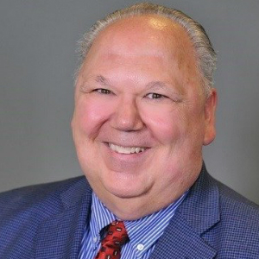
Al Jensen
SPEAKER • AUTHOR • COACH
Connect With Al Jensen on Social Media:
Facebook.com/darrell.jensen.9
Twitter.com/AlJensen
Contact Al at: 702-883-1980 www.AlJensen.com
Elevating Speakers, Executives & Marketers Communications & Confidence to the Next Stage!
Your Story is Your Unique Selling Proposition
Master Marketer, Seth Godin says “It’s not about the products or services you sell, it’s about the stories you tell”. As executives, marketers or speakers, we are all working to move our audiences to our way of thinking. No longer do we accomplish that with facts, figures or details. We do it through story. Al Jensen is a master storyteller and helps the audience understand how they can utilize the power of story to move their audiences to action in the new marketplace. Available as a Keynote (60 minutes) or breakout (45-90 minutes) or workshop (2-4 hours)
The Actions We Take
Audiences walk away with an understanding of the importance of the importance of the thoughts that we think, the words that we speak, the decisions we make all have an impact on the success and happiness in our lives. Ultimately, however, the actions we take are the primary driving force behind virtually every aspect of success in our life. Learn how to harness the power of action to create the results you crave in your life in “The Actions We Take”. Available as a Keynote (60 minutes), Breakout (45-90 minutes) or Workshop (2-4 hours)
On Stage in Vegas – Lessons You Can Learn From a Vegas Comedy Magician
If there’s one thing you can be sure of when seeing a comedy magic show in Las Vegas, it’s you’ll leave holding your side from laughing for the entire hour and asking yourself “how did he do that”? You will have been transformed from your worries and entertained for a full hour and thoroughly enjoyed yourself in the meantime. The seemingly simple laughs and illusions require a great deal of psychology, rehearsal and confidence. You’ll be amazed at the business and life lessons you can learn from this master of comedy and magic. Available as a workshop only (2-4 hours). Audience members walk away with 3 comedy formulas and 3 simple magic trick methods!
CALL AL JENSEN TODAY AT: 702-883-1980

Slide 25
“Motivational / compelling/ interesting quote from you, the speaker.” ~ SPEAKER NAME
ABOUT SPEAKER FIRST NAME
Your Bio goes here
Description of your book
WHAT YOU NEED TO KNOW:
Stat or detail about the problem
Stat or detail about the problem
Stat or detail about the problem
Stat or detail about the problem
Stat or detail about the problem
Stat or detail about the problem
Stat or detail about the problem
Stat or detail about the problem
Stat or detail about the problem
- Source: Book, website, newspaper article, magazine article, etc.
”Short Testimonial from Meeting Planner or audience member.” ~Name, Title, Location
Active Member of:

Slide 26
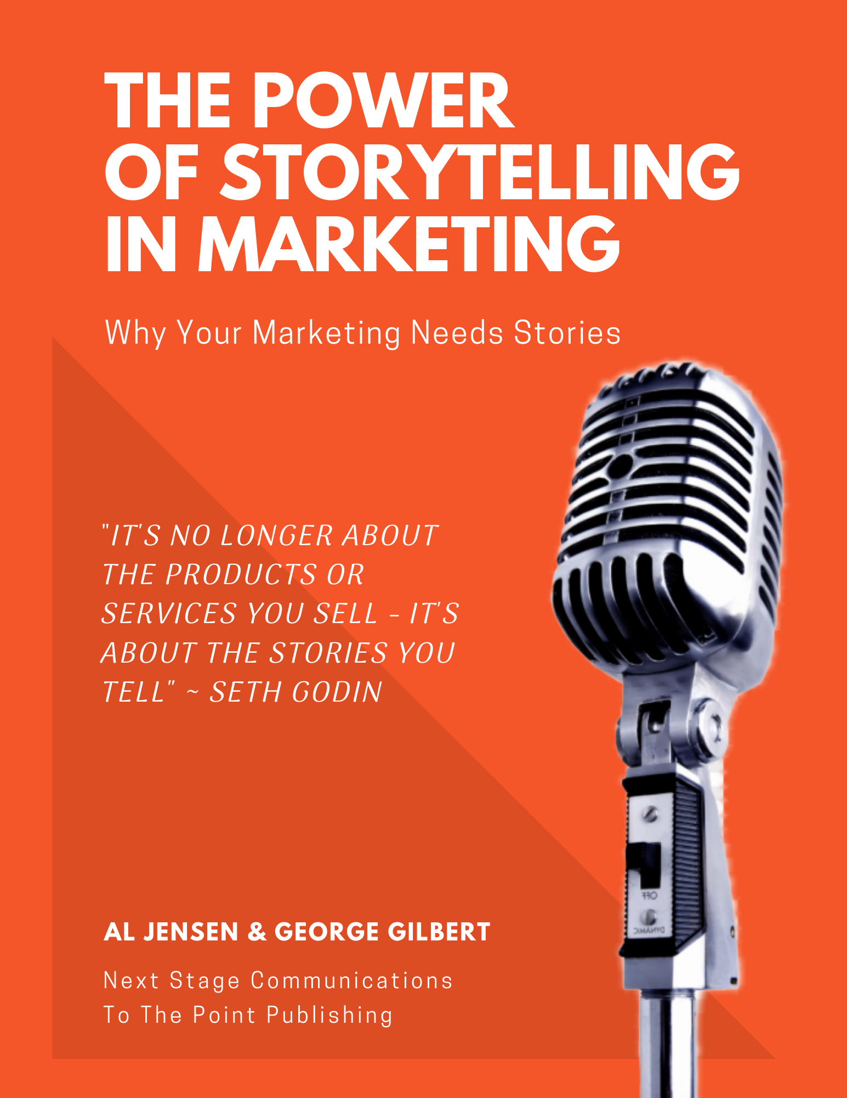
“The best presenter we’ve ever had!.” ~ Judi Moreo, President National Speakers Assn. Las Vegas
ABOUT AL JENSEN
Al Jensen is an executive speaking coach who works with entrepreneurs, authors, speakers and coaches to help them connect with and impact audiences from the platform, moving listeners to action.
Al believes that everyone has a message that can impact the world and he's dedicated to helping committed speakers learn how to move audiences to take action.
Al has coached professional sports figures, CEO's, sales people, authors and aspiring speakers to success from the platform since 1992.
In addition to training and coaching speakers, Al has spoken to and entertained more than 6,000 audiences since 1974, from 4-H Clubs in Iowa to cruise ship showrooms around the world on the high seas.
People crave stories. The likeability created by a good story has a bigger influence on the customer than any other factor. Studies show it does this by a factor of 3 to 1 for television commercials and 2 to 1 for ads.
People forget statistics and facts, but they don’t forget a good story.
This book will help you understand how to harness the power of storytelling to take your company to the next stage .
WHAT YOU NEED TO KNOW:
Speaking is the #1 fear, ahead of dying
Individuals who communicate their thoughts effectively are 17 times more likely to be promoted into management positions
Effective communicators earn, on average more than $3.7 million more than ineffective communicators over their lifetime
Effective storytellers are 16 times more likely to be promoted to the C-Suite ahead of others, regardless of educational experience
Effective storytellers will have 37 times the memory impact on an audience compared to a facts and figures presenter
Storytelling is the #1 skill sought by employers (of those seeking sales, marketing and public relations personnel in a 2019 survey)
Al Jensen has spoken to more than 6000 audiences since 1974
Jensen has served as Dean of the Speakers Academy of the National Speakers Association in Las Vegas since 2012
Jensen is the author of more than a dozen books on speaking, storytelling, sales, marketing and business development
”I love working with Al Jensen. A real pro!” ~Toni Caruso, Owner, Caruso Signature Events, Oak Park, CA
Active Member of:

Slide 27
Al Jensen
SPEAKER • AUTHOR • COACH
Connect With Al Jensen on Social Media:
Facebook.com/darrell.jensen.9
Twitter.com/AlJensen
Contact Al at: 702-883-1980 www.AlJensen.com
Elevating Speakers, Executives & Marketers Communications & Confidence to the Next Stage!
Your Story is Your Unique Selling Proposition
Master Marketer, Seth Godin says “It’s not about the products or services you sell, it’s about the stories you tell”. As executives, marketers or speakers, we are all working to move our audiences to our way of thinking. No longer do we accomplish that with facts, figures or details. We do it through story. Al Jensen is a master storyteller and helps the audience understand how they can utilize the power of story to move their audiences to action in the new marketplace. Available as a Keynote (60 minutes) or breakout (45-90 minutes) or workshop (2-4 hours)
The Actions We Take
Audiences walk away with an understanding of the importance of the importance of the thoughts that we think, the words that we speak, the decisions we make all have an impact on the success and happiness in our lives. Ultimately, however, the actions we take are the primary driving force behind virtually every aspect of success in our life. Learn how to harness the power of action to create the results you crave in your life in “The Actions We Take”. Available as a Keynote (60 minutes), Breakout (45-90 minutes) or Workshop (2-4 hours)
On Stage in Vegas – Lessons You Can Learn From a Vegas Comedy Magician
If there’s one thing you can be sure of when seeing a comedy magic show in Las Vegas, it’s you’ll leave holding your side from laughing for the entire hour and asking yourself “how did he do that”? You will have been transformed from your worries and entertained for a full hour and thoroughly enjoyed yourself in the meantime. The seemingly simple laughs and illusions require a great deal of psychology, rehearsal and confidence. You’ll be amazed at the business and life lessons you can learn from this master of comedy and magic. Available as a workshop only (2-4 hours). Audience members walk away with 3 comedy formulas and 3 simple magic trick methods!
CALL AL JENSEN TODAY AT: 702-883-1980

Slide 28
“The best presenter we’ve ever had!.” ~ Judi Moreo, President National Speakers Assn. Las Vegas
ABOUT AL JENSEN
Al Jensen is an executive speaking coach who works with entrepreneurs, authors, speakers and coaches to help them connect with and impact audiences from the platform, moving listeners to action.
Al believes that everyone has a message that can impact the world and he's dedicated to helping committed speakers learn how to move audiences to take action.
Al has coached professional sports figures, CEO's, sales people, authors and aspiring speakers to success from the platform since 1992.
In addition to training and coaching speakers, Al has spoken to and entertained more than 6,000 audiences since 1974, from 4-H Clubs in Iowa to cruise ship showrooms around the world on the high seas.
People crave stories. The likeability created by a good story has a bigger influence on the customer than any other factor. Studies show it does this by a factor of 3 to 1 for television commercials and 2 to 1 for ads.
People forget statistics and facts, but they don’t forget a good story.
This book will help you understand how to harness the power of storytelling to take your company to the next stage .
WHAT YOU NEED TO KNOW:
Speaking is the #1 fear, ahead of dying
Individuals who communicate their thoughts effectively are 17 times more likely to be promoted into management positions
Effective communicators earn, on average more than $3.7 million more than ineffective communicators over their lifetime
Effective storytellers are 16 times more likely to be promoted to the C-Suite ahead of others, regardless of educational experience
Effective storytellers will have 37 times the memory impact on an audience compared to a facts and figures presenter
Storytelling is the #1 skill sought by employers (of those seeking sales, marketing and public relations personnel in a 2019 survey)
Al Jensen has spoken to more than 6000 audiences since 1974
Jensen has served as Dean of the Speakers Academy of the National Speakers Association in Las Vegas since 2012
Jensen is the author of more than a dozen books on speaking, storytelling, sales, marketing and business development
”I love working with Al Jensen. A real pro!” ~Toni Caruso, Owner, Caruso Signature Events, Oak Park, CA
Active Member of:

Slide 29
Resources to support your Speaker One Sheet Development
https://speakerhub.com/blog/speaker-one-sheet-template
Highly Recommended: Kimb Williams at Senjula.com Professional designer
http://senjula.com/Professional-Speakers-One-Sheets-and-Graphic-Design-Services.html
My regular rate is $400 USD, if you send me someone I will knock that down to $275 USD, Once they sign up I need a $100 USD deposit. Their balance of $175 will be due upon completion. All payments are done through PayPal only. Also I do not start any work until they have paid the deposit. Kimb Williams Here’s some random on-line resources I’ve got bookmarked in my computer you may find useful:
http://happyselfpublisher.com/speaker-one-sheet/
https://jeanniespiro.com/how-to-create-your-speaker-one-sheet/
https://www.communicatoracademy.com/2019/07/22/create-an-impressive-speaker-one-sheet/
Here’s another template for you! https://www.communicatoracademy.com/wp-content/uploads/2019/07/071519-CABLOG-SpeakerOneSheet.pdf
If you’d like additional Speaker One Sheet templates featured in the workshop, Next Stage Communications will make them available to you at the super affordable price of $25 for the entire suite of various formats and colors to use at your discretion. This is a single license, not to be sold or shared with others.
If you’d like a DWY (Done With You) Speaker One Sheet package, Next Stage Communications will offer you the opportunity to choose one template from the suite of templates and up to 60 minutes of one-on-one joint designing time to complete your speaker one sheet at a ridiculously low price of only $125. You’d need to have your head shot, bio and other information substantially ready prior to the design session to make the best use of your design session time.
Need a new Head Shot? Michael Rogers, a local photographer has provided us with a link to schedule a session for an unbelievably priced head shot session at only $25. Sessions are limited and you must book through this link: https://theorymedia.clickfunnels.com/mwrphoto37134081 Several Speakers Enrichment Academy members have taken advantage of his special offer so we can confidently recommend this as a super deal!

Slide 30
Thanks for joining us today!

